Slide 1
The Market I
Students should be able to demonstrate an understanding on the types of market and the concept of market equilibrium

Slide 2
Define market
A situation where buyers and sellers (consumers and producers) exchange economic goods and services for a monetary price. This can be a building (shops or market house), on a street with a hand shake, online, during a phone call etc…

Slide 3
Perfect Competition
https://www.investopedia.com/terms/p/perfectcompetition.asp
A situation of perfect competition is characterized by many sellers. Pure or perfect competition is a theoretical market structure in which the following criteria are met: All firms sell an identical product (the product is a "commodity" or "homogeneous"). All firms are price takers (they cannot influence the market price of their product). Market share has no influence on prices. Example Kava jus market
Jun 25, 2019

Slide 4
Monopoly
https://economictimes.indiatimes.com/definition/monopoly
Definition of 'Monopoly' Definition: A market structure characterized by a single seller, selling a unique product in the market. In a monopoly market, the seller faces no competition, as he is the sole seller of goods with no close substitute. ... He enjoys the power of setting the price for his goods.

Slide 5
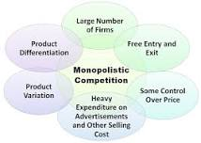
Monopolistic Competition
https://www.investopedia.com/terms/m/monopolisticmarket.asp
Monopolistic competition characterizes an industry in which many firms offer products or services that are similar, but not perfect substitutes. Barriers to entry and exit in a monopolistic competitive industry are low, and the decisions of any one firm do not directly affect those of its competitors.
May 1, 2019

Slide 6
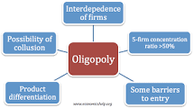
Oligopoly
https://www.investopedia.com/terms/o/oligopoly.asp
Oligopoly is a market structure with a small number of firms, none of which can keep the others from having significant influence. The concentration ratio measures the market share of the largest firms. A monopoly is one firm, duopoly is two firms and oligopoly is two or more firms.
May 1, 2019

Slide 7
Duopoly
https://www.investopedia.com/terms/d/duopoly.asp
A duopoly is a situation where two companies own all, or nearly all, of the market for a given product or service. A duopoly is the most basic form of oligopoly, a market dominated by a small number of companies.
Apr 13, 2019

Slide 8
Demand/Supply and Equilibrium
Market Supply Schedule For Kava
Quantity (Number of Shells) | Price (Vatu VuV)
10 | 50
20 | 100
30 | 150
40 | 200
Market Supply Curve For Kava
at Tagabe Area

Slide 9
Demand/Supply and Equilibrium
Market Demand Schedule For Kava
Quantity (Number of Shells) | Price (Vatu VuV)
40 | 50
30 | 100
20 | 150
10 | 200
Market Demand Curve For Kava
at Tagabe Area

Slide 10
Demand/Supply and Equilibrium
Market Schedule For Kava at Tagabe Area
Quantity Demanded (Number of Shells) | Quantity Supplied (Number of Shells) | Price (Vatu VuV)
40 | 10 | 50
30 | 20 | 100
20 | 30 | 150
10 | 40 | 200
Market Curve For Kava
at Tagabe Area

Slide 11
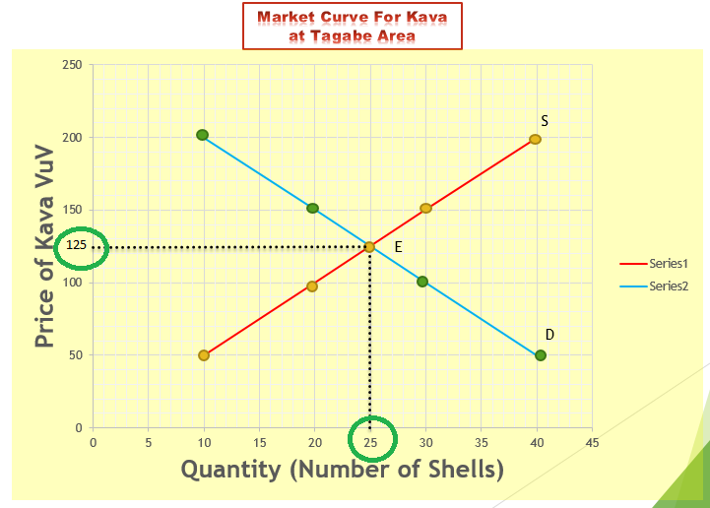
Demand/Supply and Equilibrium
Market Schedule For Kava at Tagabe Area
Quantity Demanded (Number of Shells) | Quantity Supplied (Number of Shells) | Price (Vatu VuV)
40 | 10 | 50
30 | 20 | 100
25 | 25 | 125
20 | 30 | 150
10 | 40 | 200

Slide 12
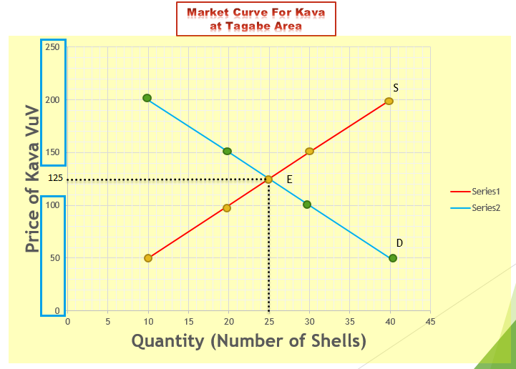
Demand/Supply and Equilibrium
Market Schedule For Kava at Tagabe Area
Quantity Demanded (Number of Shells) | Quantity Supplied (Number of Shells) | Price (Vatu VuV)
40 | 10 | 50
30 | 20 | 100
25 | 25 | 125
20 | 30 | 150
10 | 40 | 200

Slide 13
Demand/Supply and Equilibrium
Market Schedule For Kava at Tagabe Area
Quantity Demanded (Number of Shells) | Quantity Supplied (Number of Shells) | Price (Vatu VuV)
40 | 10 | 50
30 | 20 | 100
25 | 25 | 125
20 | 30 | 150
10 | 40 | 200
Excess Demand
/Shortage

Slide 14
Excess Demand
QD>QS
QS<QD
Market Schedule For Kava at Tagabe Area
Quantity Demanded (Number of Shells) | Quantity Supplied (Number of Shells) | Price (Vatu VuV)
40 | 10 | 50
30 | 20 | 100
25 | 25 | 125
20 | 30 | 150
10 | 40 | 200
Excess Demand
(Shortage)

Slide 15
Excess Demand
QD<QS
QS>QD
Market Schedule For Kava at Tagabe Area
Quantity Demanded (Number of Shells) | Quantity Supplied (Number of Shells) | Price (Vatu VuV)
40 | 10 | 50
30 | 20 | 100
25 | 25 | 125
20 | 30 | 150
10 | 40 | 200
Excess Supply
(Surplus)

Slide 16
Demand/Supply and Equilibrium
Market Schedule For Kava at Tagabe Area
Quantity Demanded (Number of Shells) | Quantity Supplied (Number of Shells) | Price (Vatu VuV)
40 | 10 | 50
30 | 20 | 100
25 | 25 | 125
20 | 30 | 150
10 | 40 | 200
E’
D’

Slide 17
Demand/Supply and Equilibrium
Market Schedule For Kava at Tagabe Area
Quantity Demanded (Number of Shells) | Quantity Supplied (Number of Shells) | Price (Vatu VuV)
40 | 10 | 50
30 | 20 | 100
25 | 25 | 125
20 | 30 | 150
10 | 40 | 200
S’
E’’
E’
D’
D’

